Slide 1
Chapter One
Elasticity

Slide 2
Elastic Properties of Materials
Stress
Strain
Young’s Modulus
Hooke’s Law

Slide 3

Elasticity
An elastic body is one that returns to its original shape after a deformation.
Rubber Band

Slide 4
An inelastic body is one that does not return to its original shape after a deformation.
Clay

Slide 5
Elastic or Inelastic?
An elastic collision loses no energy. The deformation on collision is fully restored.
In an inelastic collision, energy is lost and the deformation may be permanent.

Slide 6
Stress and Strain
stress: describes the applied forces
strain: describes the resulting deformation
modulus: property of material under stress
(large modulus means small deformation)
Hooke’s Law: stress = modulus × strain

Slide 7
Types of Stress and Strain
Applied forces are perpendicular to surface:
tensile stress
bulk (volume) stress
Applied forces are parallel to surface:
shear stress

Slide 8
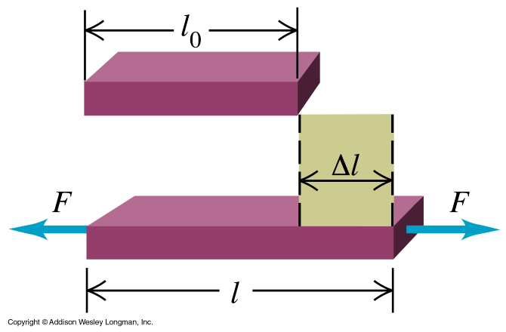
Tensile Stress and Strain
tensile stress = F/A
tensile strain = Δl/l₀
Young’s modulus = Y

Slide 9
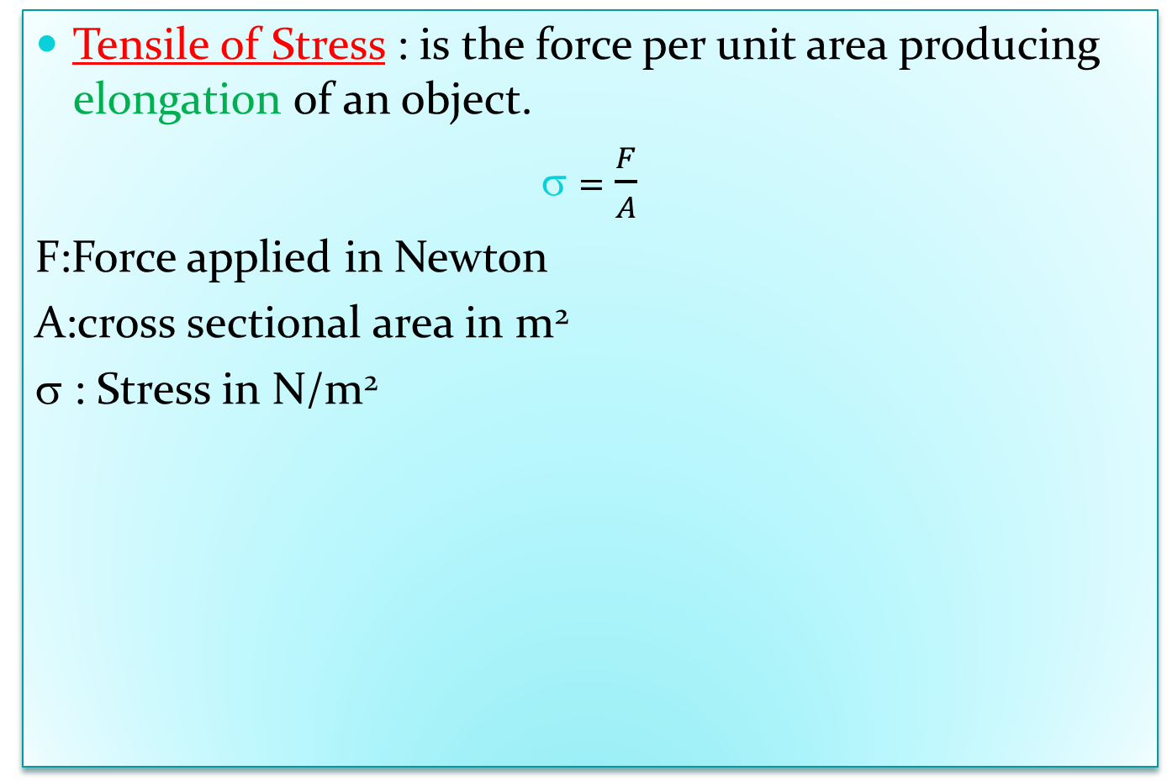
Tensile of Stress : is the force per unit area producing elongation of an object.
= $\frac{F}{A}$
F:Force applied in Newton
A:cross sectional area in m²
σ : Stress in N/m²
A
F
A
Tensile

Slide 10
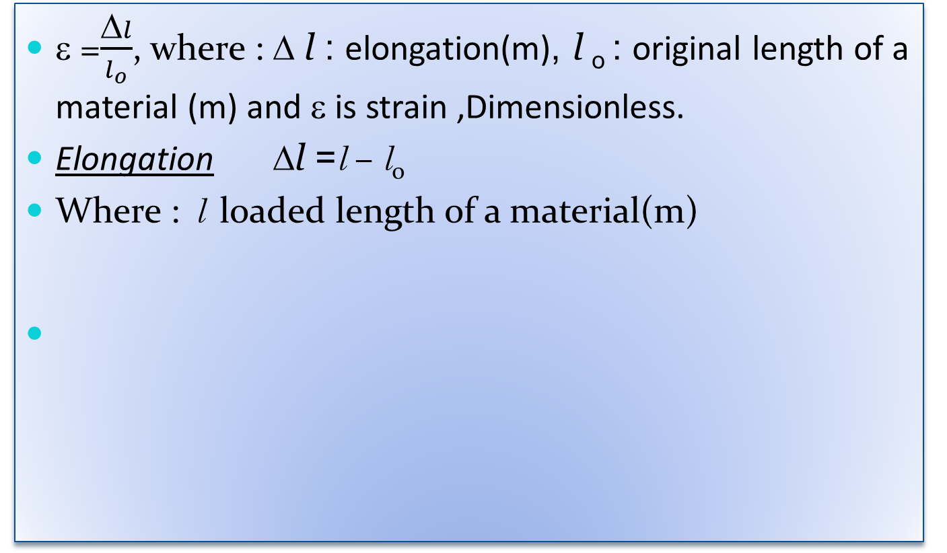
Strain :Ratio of elongation of material to the original length
ε =$\frac{Δl}{l_{o}}$, where : Δ l : elongation(m), l _{o} : original length of a material (m) and ε is strain ,Dimensionless.
Elongation Δl =l – l_{o}
Where : l loaded length of a material(m)
l_{o}
l

Slide 11
Shear of Stress : is the opposite “sliding force “ applied to parallel force of the object . Producing change in shape of material without changing its volume
F
F
Shear

Slide 12
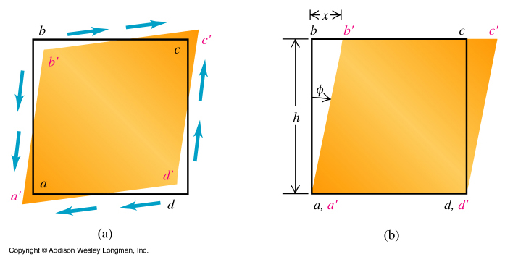
Shear Stress and Strain

Slide 13
Shear Stress and Strain
shear stress = F₇/A
shear strain = Δx/h = tanφ
shear modulus = S

Slide 14
Shear Stress and Strain

Slide 15
Deformation types and define an elastic modulus
1.Young’s modulus(Y) ,which measures the resistance of a solid to a change in its length.
نتوقع معامل يونح للحديد اكبر من معامل يونج للمطاط
2. Bulk modulus(B) , which measures the resistance of solider or liquids to changes in their volume.
3. Shear modulus(S) ,which measures the resistance to motion of the planes within a solid parallel to each other.

Slide 16
Young's modulus (E or Y) :
is a measure of a solid's stiffness or resistance to elastic deformation under load. It relates stress (force per unit area) to strain (proportional deformation) along an axis or line. The basic principle is that a material undergoes elastic deformation when it is compressed or extended, returning to its original shape when the load is removed. More deformation occurs in a flexible material compared to that of a stiff material. In other words:
A low Young's modulus value means a solid is elastic.
A high Young's modulus value means a solid is inelastic or stiff.

Slide 17
Units
stress = modulus × strain
stress (‘applied force’): pascal= Pa=N/m²
strain (‘deformation’): dimensionless
modulus: same unit as stress

Slide 18
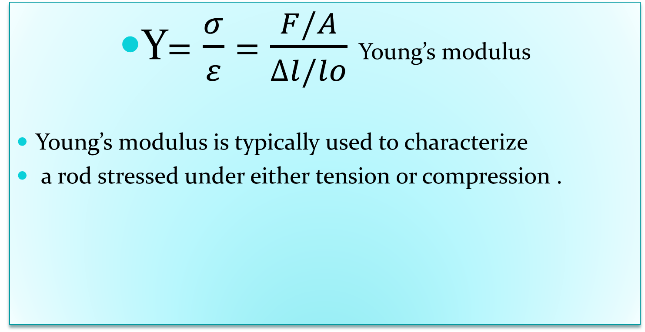
Young’s Modulus : Elasticity in Length
Y= $\frac{σ}{ε}$ = $\frac{F/A}{∆l/lo}$ Young’s modulus
Young’s modulus is typically used to characterize
a rod stressed under either tension or compression .

Slide 19
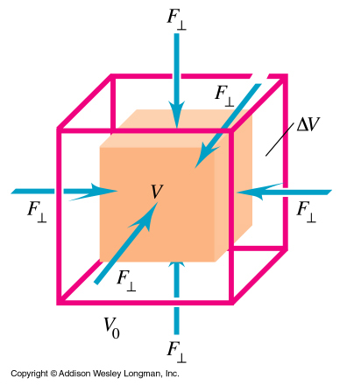
Bulk Stress and Strain
pressure: p=F/A
bulk stress = Δp
bulk strain = ΔV/V₀
bulk modulus = B

Slide 20
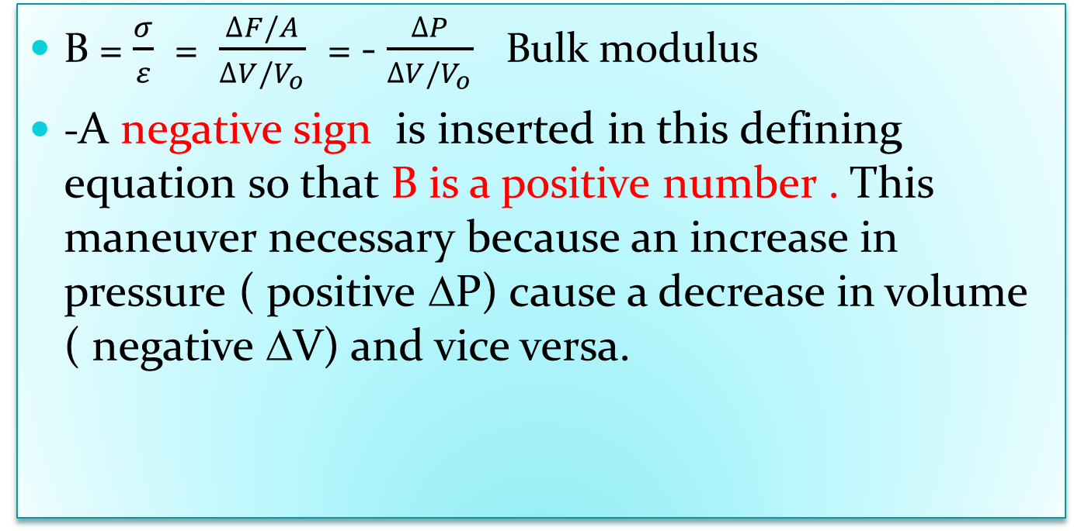
Bulk Modulus : Volume Elasticity
B = $\frac{σ}{ε}$ = $\frac{∆F/A}{∆V/V_{o}}$ = - $\frac{∆P}{∆V/V_{o}}$ Bulk modulus
-A negative sign is inserted in this defining equation so that B is a positive number . This maneuver necessary because an increase in pressure ( positive ΔP) cause a decrease in volume ( negative ΔV) and vice versa.

Slide 21
Shear Modulus :Elasticity of Shape
A shearing stress alters only the shape of the body, leaving the volume unchanged. For example, consider equal and opposite shearing forces F acting on the cube below:
d
A
F
l
φ
F
The shearing force F produces a shearing angle φ. The angle φ is the strain and the stress is given by F/A as before.

Slide 22
Calculating Shear Modulus
d
A
Stress is force per unit area:
φ
F
l
F
The strain is the angle expressed in radians:
The shear modulus S is defined as the ratio of the shearing stress F/A to the shearing strain φ:
The shear modulus: Units are in Pascals.

Slide 23
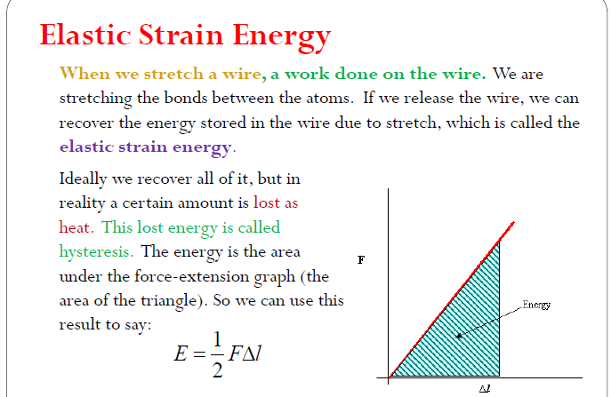

Slide 24
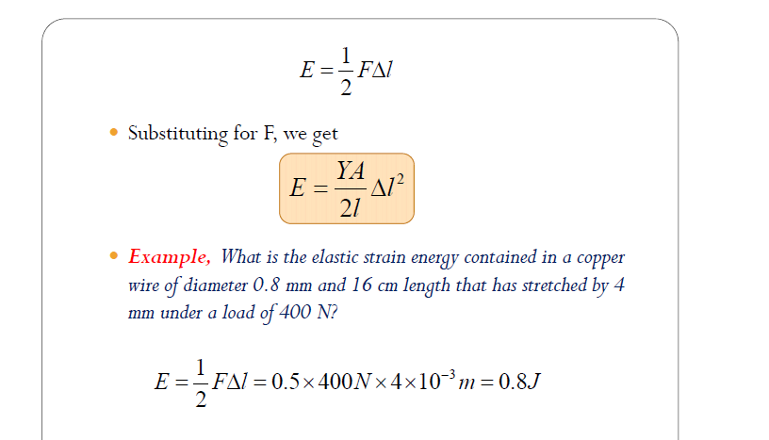

Slide 25
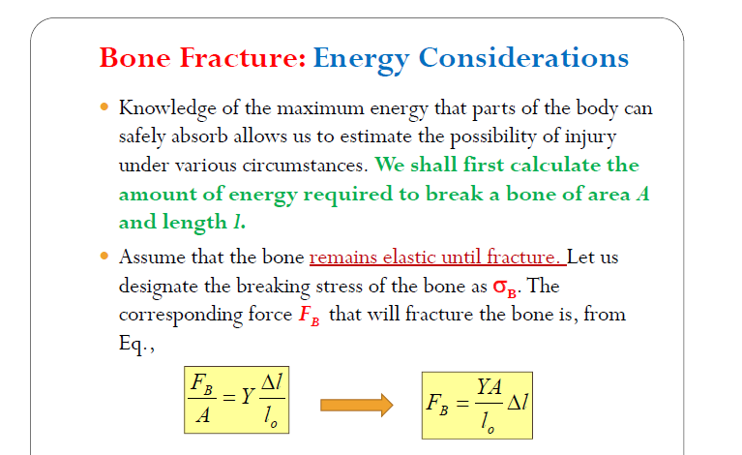

Slide 26
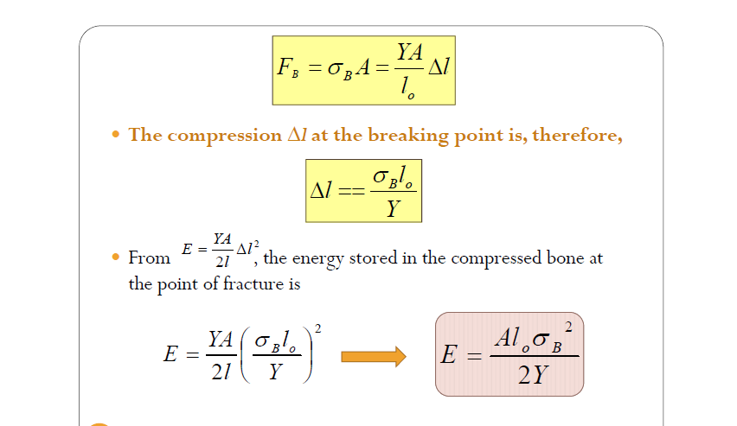

Slide 27
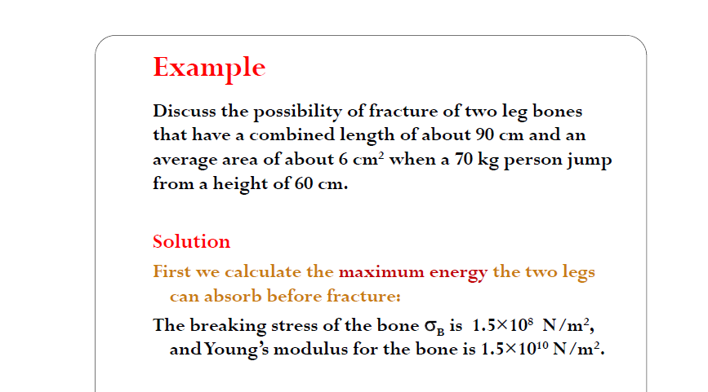
ناقش إمكانية حدوث كسر في عظمتي ساق يبلغ طولهما الإجمالي حوالي 90 سم ومساحتهما المتوسطة حوالي 6 سم2 عندما يقفز شخص يزن 70 كجم من ارتفاع 60 سم
.

Slide 28
Relation between Stress and Strain
The relation between the stress and the strain for a material under tension can be found experimentally .
A plot of stress vs. strain .
The diagram gives us the behavior of the material and material properties

Slide 29
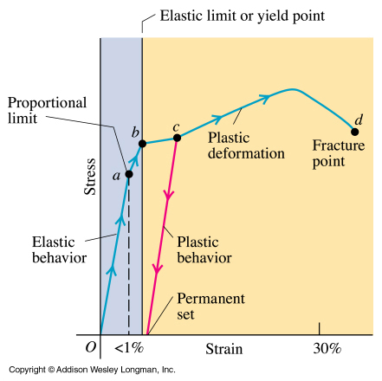
Regimes of Deformation
O to a :
(small stress, strain)
stress=modulus × strain
elastic, reversible
a < b :
elastic, reversible
but stress and strain
not proportional

Slide 30
Regimes of Deformation
From point O to b :
elastic, reversible
from point b to d:
plastic, irreversible
ductile materials have long c–d curves
brittle materials have short c–d curves

Slide 31
Typical Values for Elastic Modulus
substance | Young’s Modulus (N/m²) | Shear Modulus (N/m²) | Bulk Modulus (N/m²)
Tungsten | 35x10¹⁰ | 14x10¹⁰ | 20x10¹⁰
Steel | 20x10¹⁰ | 8.4x10¹⁰ | 6x10¹⁰
Copper | 11x10¹⁰ | 4.2x10¹⁰ | 14x10¹⁰
Brass | 9.1x10¹⁰ | 3.5x10¹⁰ | 6.1x10¹⁰
Aluminum | 7.0x10¹⁰ | 2.5x10¹⁰ | 7.0x10¹⁰
Glass | 6.5-7.8x10¹⁰ | 2.6-3.2x10¹⁰ | 5.0-5.5x10¹⁰
Quartz | 5.6x10¹⁰ | 2.6x10¹⁰ | 2.7x10¹⁰
Water | --------- | ------- | 0.21x10¹⁰
Mercury | --------- | ------- | 2.8x10¹⁰

Slide 32
Deformations Summary Table
Tensile or compressive
Shear
Volume
Stress
Force per unit cross-sectional area
Shear force divided by the area of the surface on which it acts
Pressure
Strain
Fractional change in length
Ratio of the relative displacement to the separation of the two parallel surfaces
Fractional change in volume
Constant of proportionality
Young’s modulus (Y)
Shear modulus (S)
Bulk Modulus (B)

Slide 33
Exercise

Slide 34

Example:A 10⁸N/m² stress produces a strain 5x10⁻⁴. What is Young’s modulus for this bar?
Given: σ= 10⁸ N/m²; ε = 5x10⁻⁴
$$Y=\frac{σ}{ε}=\frac{\text{10}\text{8 }\text{N}\text{/}\text{m}\text{2}}{\text{5}\text{x}\text{10}\text{−}\text{4 }}$$
Young’s modulus
20x10¹⁰ N/m²

Slide 35
Example : A steel wire 10 m long and 2 mm in diameter is attached to the ceiling and a 200-N weight is attached to the end. What is the applied stress?
First find area of wire:
L
A
F
A
ΔL
A = 3.14 x 10⁻⁶ m²
Stress
6.37 x 10⁷ Pa

Slide 36
Example : A 10 m steel wire stretches 3.08 mm due to the 200 N load. What is the longitudinal strain?
Given: L = 10 m; ΔL = 3.08 mm
L
ΔL
Longitudinal Strain
3.08 x 10⁻⁴

Slide 37
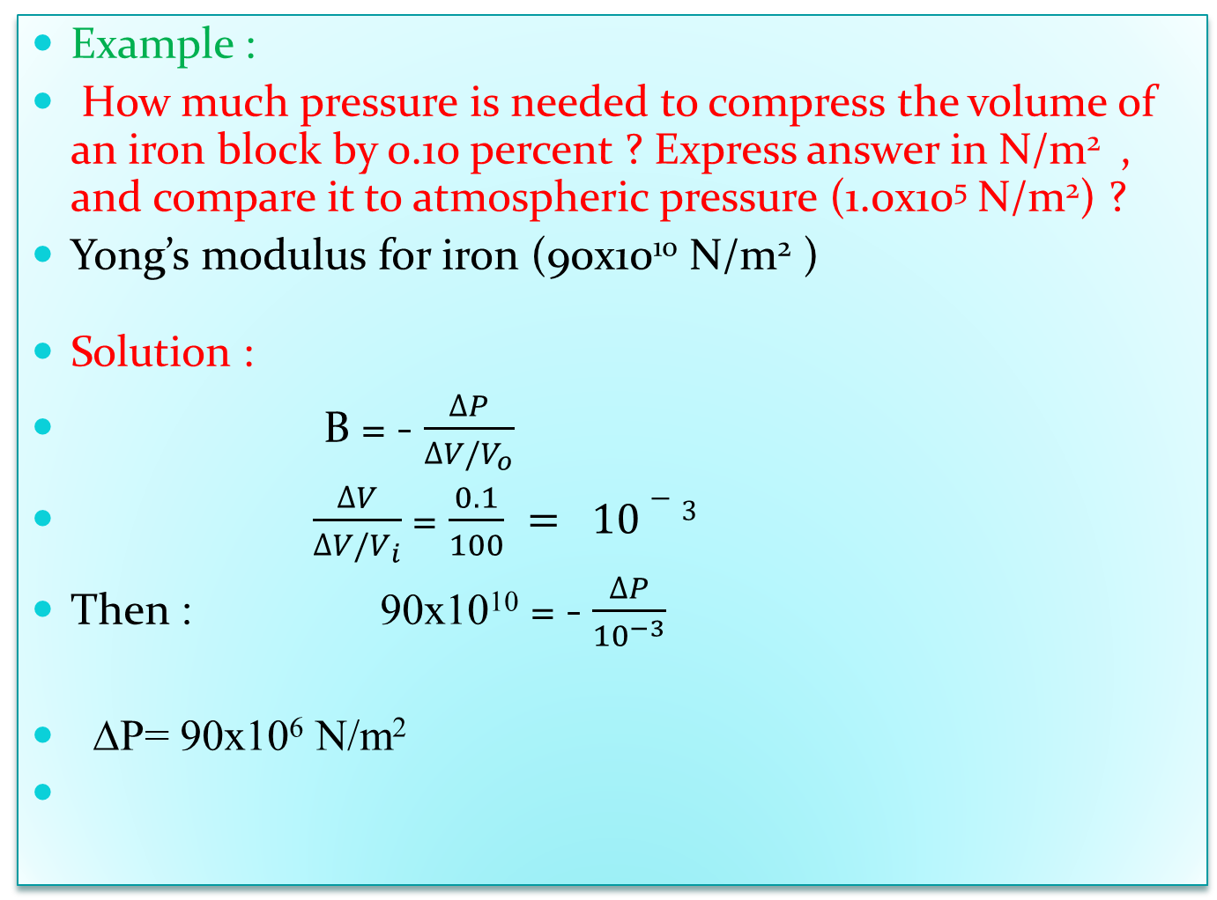
Example :
How much pressure is needed to compress the volume of an iron block by 0.10 percent ? Express answer in N/m² , and compare it to atmospheric pressure (1.0x10⁵ N/m²) ?
Yong’s modulus for iron (90x10¹⁰ N/m² )
Solution :
B = - $\frac{∆P}{∆V/V_{o}}$
$\frac{∆V}{∆V/V_{i}}$ = $\frac{0.1}{100} = 10−3$
Then : 90x10¹⁰ = - $\frac{∆P}{{10}^{−3}}$
ΔP= 90x10⁶ N/m²

Slide 38
Example : The upper surface of a cube of gelatin, 5.0 cm on a side, is displaced by 0.64 cm by a tangential force. The shear modulus of the gelatin is 940 Pa. What is the magnitude of the tangential force?
F
F
From Hooke’s Law:

Slide 39
Example : An anchor, made of cast iron of bulk modulus 60.0×10⁹ Pa and a volume of 0.230 m³, is lowered over the side of a ship to the bottom of the harbor where the pressure is greater than sea level pressure by 1.75×10⁶ Pa. Find the change in the volume of the anchor.

Slide 40
Example: A steel beam is placed vertically in the basement of a building to keep the floor above from sagging. The load on the beam is 5.8×10⁴ N and the length of the beam is 2.5 m, and the cross-sectional area of the beam is 7.5×10⁻³ m². Find the vertical compression of the beam.
Force of ceiling on beam
Force of floor on beam
For steel Y = 200×10⁹ Pa.

Slide 41
Example : A hydrostatic press contains 5 liters of oil. Find the decrease in volume of the oil if it is subjected to a pressure of 3000 kPa. (Assume that B = 1700 MPa.)
Decrease in V; milliliters (mL):
ΔV = -8.82 mL

Slide 42
Example :
The stress applied to the steel wire was 6.37 x 10⁷ Pa and the strain was 3.08 x 10⁻⁴. Find the modulus of elasticity for steel.
L
Y = 207 x 10⁹ Pa
ΔL
This longitudinal modulus of elasticity is called Young’s Modulus and is denoted by the symbol Y.

Slide 43
Example: A steel stud (S = 8.27 x 10¹⁰Pa) 1 cm in diameter projects 4 cm from the wall. A 36,000 N shearing force is applied to the end. What is the defection d of the stud?
l
d
F
Area: A = 7.85 x 10⁻⁵ m²
d = 0.222 mm

Slide 44
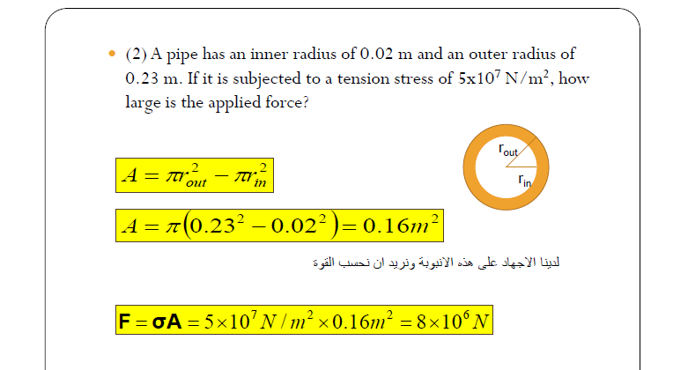

Slide 45
Hooke’s Law
When a spring is stretched, there is a restoring force that is proportional to the displacement.
x
F = -kx
F
m
The spring constant k is a property of the spring given by:
The spring constant k is a measure of the elasticity of the spring.

Slide 46
Hook’s Law
An Elastic Spring
A spring is an example of an elastic body that can be deformed by stretching
A restoring force, F, acts in the direction opposite the displacement of the oscillating body.
F = -kx
F
x

Slide 47
Hooke’s Law
A spring can be stretched or compressed with a force.
The force by which a spring is compressed or stretched is proportional to the magnitude of the displacement (F α x).
Hooke’s Law:
  F_{elastic} = -kx
    Where:
  k = spring constant = stiffness of spring (N/m)
  x = displacement

Slide 48
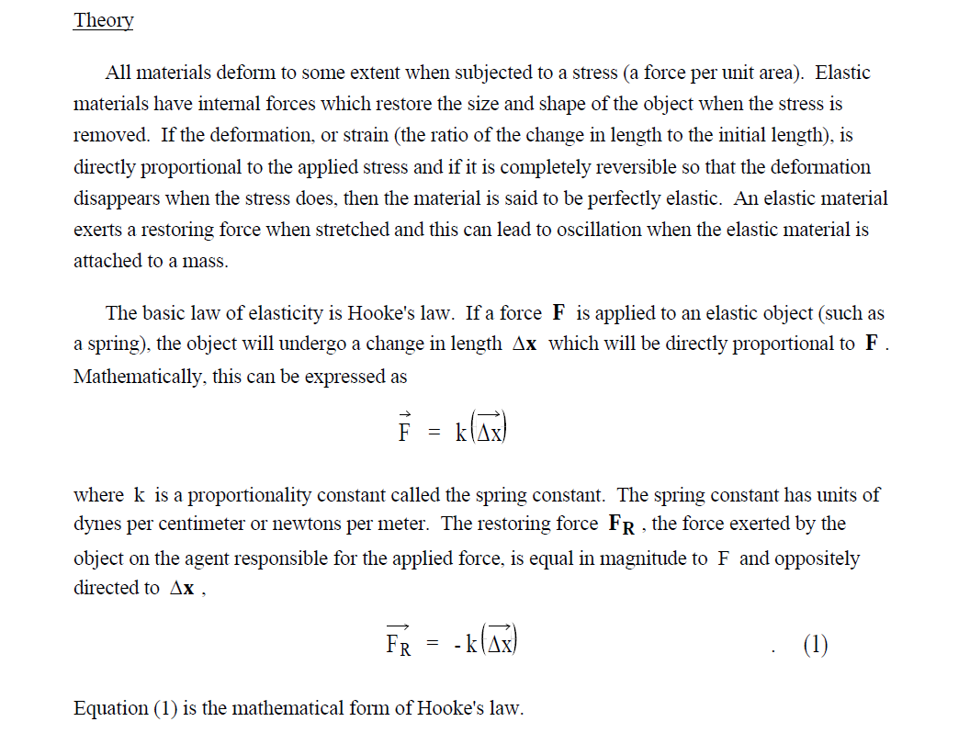

Slide 49
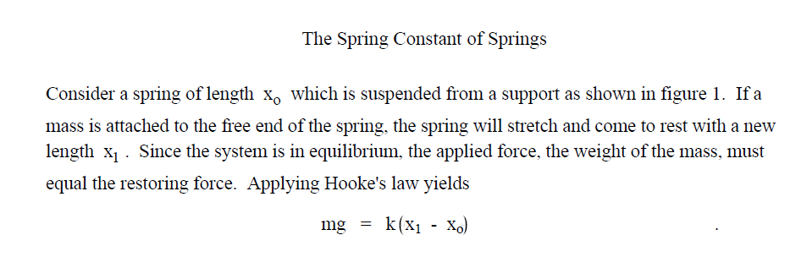
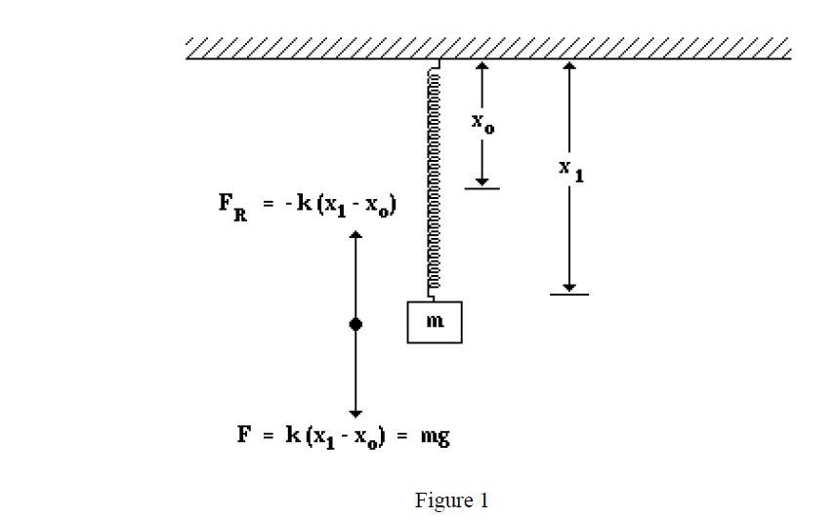

Slide 50
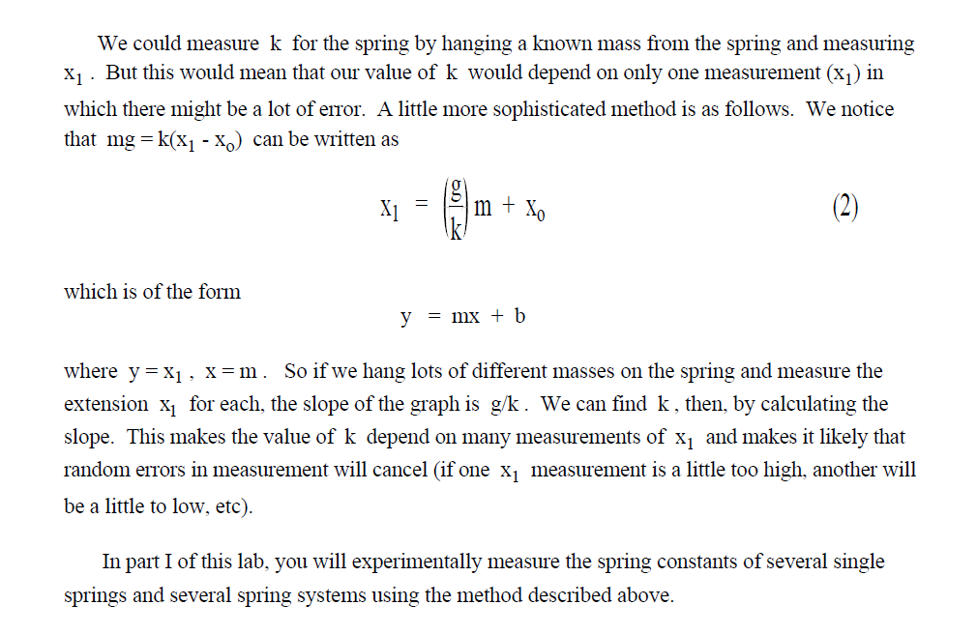

Slide 51
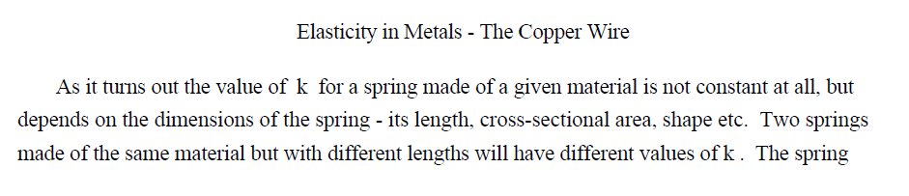
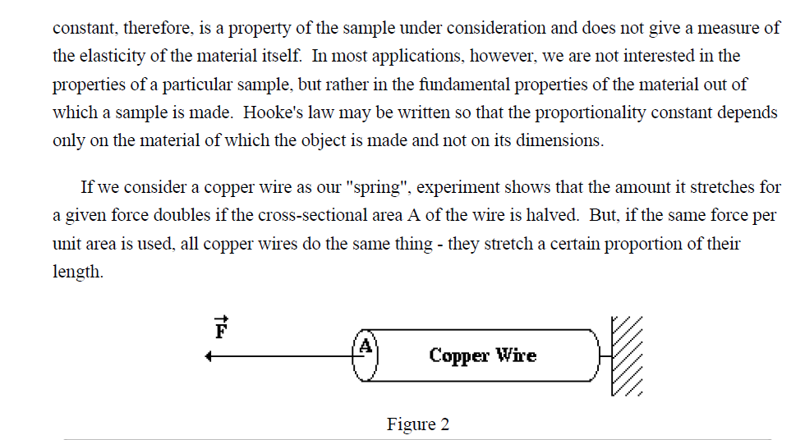

Slide 52
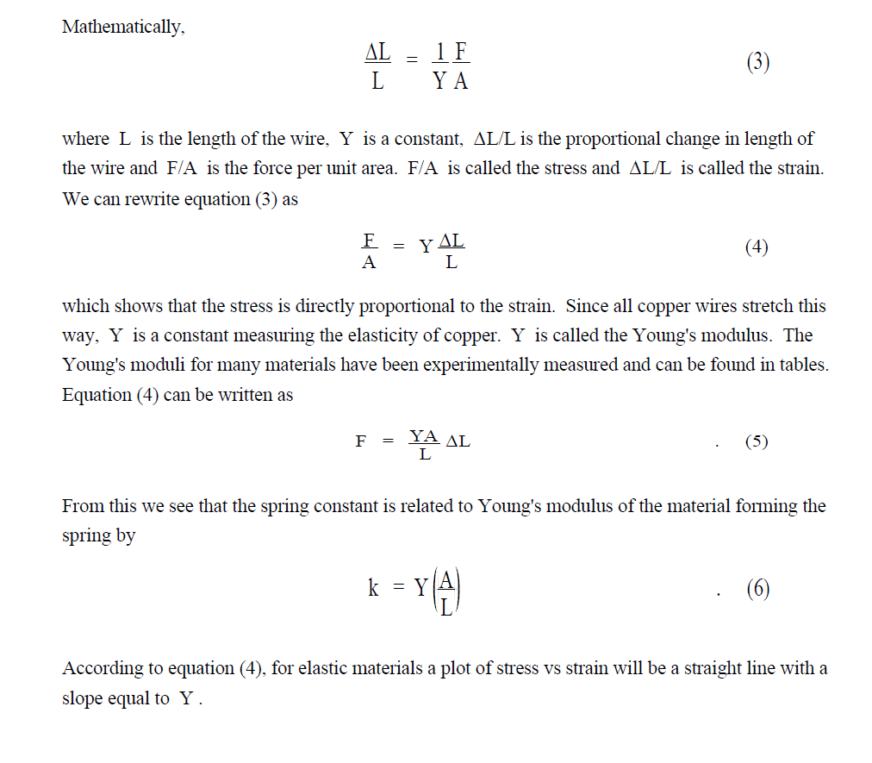

Slide 53
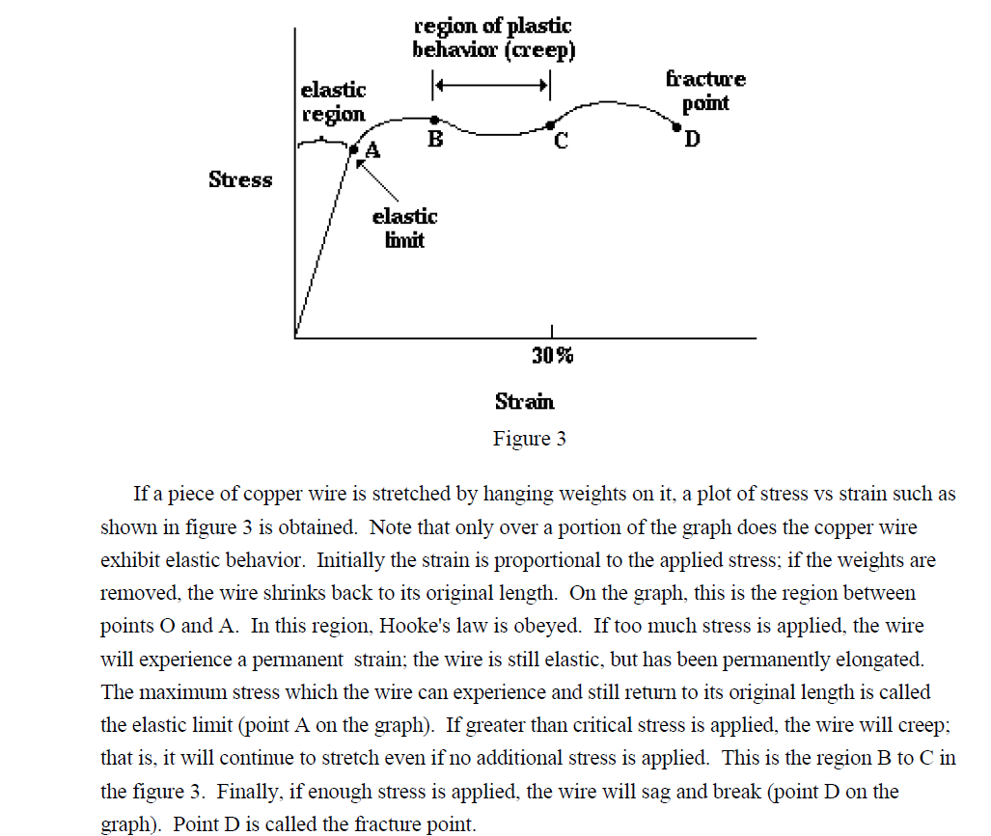

Slide 54
Example: A spring is 0.38m long. When it is pulled by a force of 2.0 N, it stretches to 0.42 m. What is the spring constant? Assume the spring behaves elastically.
Extension, ∆x = Stretched length – Original length = . 0.42m – 0.38m = 0.04 m
2.0N = k × 0.04m
So, k = 2.0 N
0.04 m
= 50 N m⁻¹

Slide 55
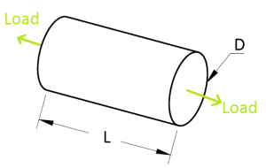
Poisson’s ratio
Shear stress – strain diagram
Consider a rod of length L, Diameter d and two forces acting at the ends of the Rod as shown in the figure. Then there would be deformation in the length and the diameter of the rod.

Slide 56
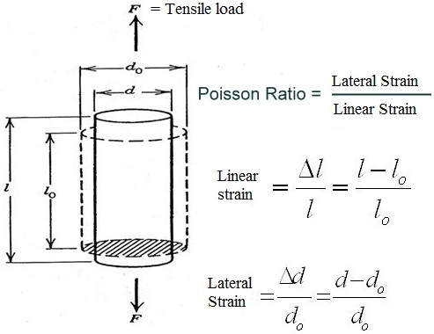
See the Gif image below. The changed Length and diameter would be Δl and Δd respectively.

Slide 57
Then :
Lateral (Transverse )Strain is the ratio of Change in diameter(Δd) to its original diameter(d₀).
In Pull type of load, the diameter goes on decreasing, so it will be negative(-ve).
Linear(Longitudinal) Strain is the ratio of Change in Length(ΔL) to original length (Lo).
In Pull type of load, the length goes on increasing, so it will be positive(+ve).

Slide 58
Definition of Poisson's ratio
Poisson's ratio : is the ratio of lateral strain(transverse contraction) strain to longitudinal extension strain in the direction of stretching force.
Tensile deformation is considered positive and compressive deformation is considered negative.
The definition of Poisson's ratio contains a minus sign so that normal materials have a positive ratio.
Poisson's ratio, also called Poisson ratio or the Poisson coefficient, or coefficient de Poisson, is usually represented as a lower case Greek nu, ν.

Slide 59

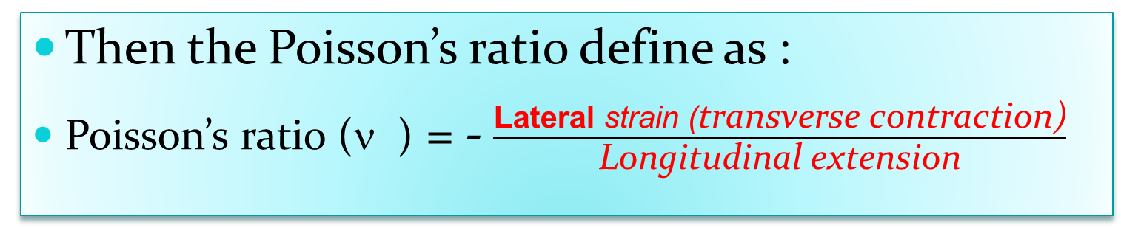
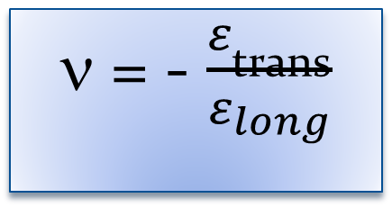
$σ_{axial}$=$\frac{F_{x}}{A}$
ε_{long} = $\frac{L^{′}−L}{L}$
ε _{later(trans)} = $\frac{d^{′}−d}{d}$
Then the Poisson’s ratio define as :
Poisson’s ratio (ν ) = - $\frac{\text{Lateral} \text{strain}\text{ (}\text{transverse} \text{contraction}\text{)}}{\text{L}\text{ongitudinal} \text{extension}}$
ν = - $\frac{ε_{\text{trans}}}{ε_{long}}$

Slide 60

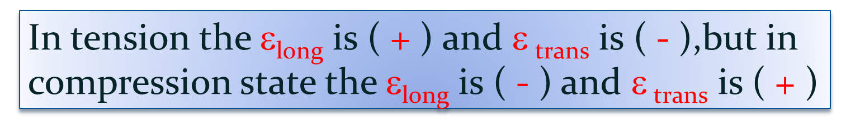
In tension the ε_{long} is ( + ) and ε $\text{trans}$ is ( - ),but in compression state the ε_{long} is ( - ) and ε $\text{trans}$ is ( + )
A positive (tensile) strain in one direction will also contribute a negative (compressive) strain in the other direction, just as stretching a rubber band to make it longer in one direction makes it thinner in the other directions .
For homogeneous ,isotropic solids :
0$≤ ≤0.5$

Slide 61

The Poisson’s ratio is also related to the compressibility of the material. The bulk modulus K or (B) , also called the modulus of compressibility, is the ratio of the hydrostatic pressure p needed for a unit relative decrease in volume ∆V/V:
B(K) =- $\frac{p}{ΔV/V}$

Slide 62
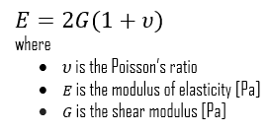

where the minus sign indicates that a compressive pressure (traditionally considered positive) produces a negative volume change. It can be shown that for isotropic materials the bulk modulus is related to the elastic modulus and the Poisson’s ratio as
K = $\frac{E}{3(1−2ν)}$

Slide 63
Poisson’s ratio for important material
Material | Poisson’s Ratio
Cork | 0.5
Rubber | 0.48 to 0.5
Lead | 0.44
Copper | 0.37
Aluminum | 0.35
Stainless Steel | 0.3
Steel | 0.29

Slide 64
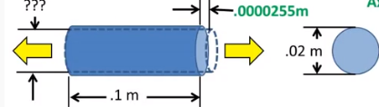
Example:
A cylindrical steel rod with diameter of 0.02m and length of 0.1m(with no force acting on it) it has a load applied in tension of 16KN .Find the change in diameter given a poisson ratio of the material of 0.29 .We previously the deformation portion in the axial direction and got a axial deformation of 2.55x10⁻⁵ m (0.0255mm)

Slide 65
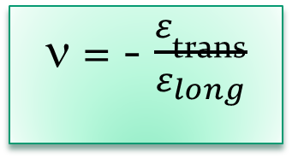
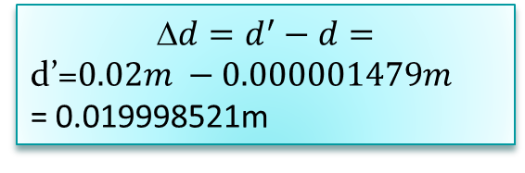
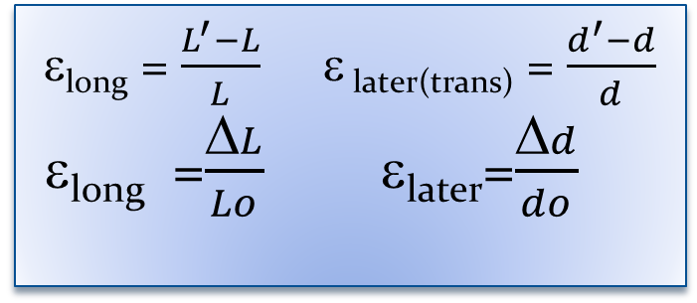
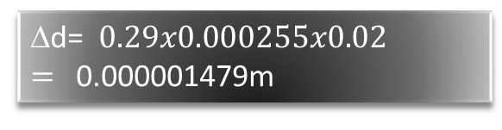
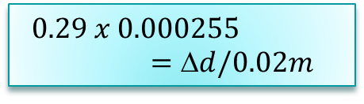
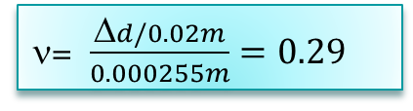
ν = - $\frac{ε_{\text{trans}}}{ε_{long}}$
ε_{long} = $\frac{L^{′}−L}{L}$ ε _{later(trans)} = $\frac{d^{′}−d}{d}$
ε_{long} =$\frac{ΔL}{Lo}$ ε_{later}=$\frac{Δd}{do}$
ν=0.29
Diameter1 = 0.02m
Length1=0.1m
Axial strain =Axial deformation /length
Axial strain =0.0000255/0.1m=0.000255m
ν= $\frac{Δd/0.02m}{0.000255m}=0.29$
$$0.29 x 0.000255=d/0.02m$$
$$d=d^{′}−d=$$
d’=$0.02m −0.000001479m$
= 0.019998521m
Δd= $0.29x0.000255x0.02=$0.000001479m

Slide 66
